Slide 1




Using Digitized Specimen Data in Research: Applications for Ecology, Phylogenetics, and Biogeography
Pam Soltis
University of Florida
BiotaPhy

Slide 2
Topics
Downloading data
Georeferencing
GEOLocate
Ecological Niche Modeling
Maxent
ENM Analysis & Interpretation
Scaling Up – BiotaPhy
Linking to phylogeny – BiotaPhy
Phylogenetic Diversity – BiotaPhy
Additional uses of collections data

Slide 3

Workshop Leaders
Pam Soltis
Lauren Whitehurst
Shelly Gaynor
Tal Kinser
Andre Naranjo
Doug Soltis
Hannah Marx
Maria Cortez
Hector Figueroa
Jon Spoelhof
CJ Grady
Makenzie Mabry
BiotaPhy

Slide 4
Logistics
Dropbox folder
https://www.dropbox.com/sh/fux2xw36nn5wwd3/AAAVK91KYwQCJ86zKHx6Ocnca?dl=0
Word doc with schedule and instructions
Presentations folder
Demos folder
Google doc
https://tinyurl.com/6fckt5j3
sign-in space
questions and comments
Workshop evaluation survey
by email
Pace

Slide 5
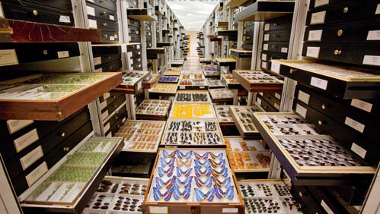
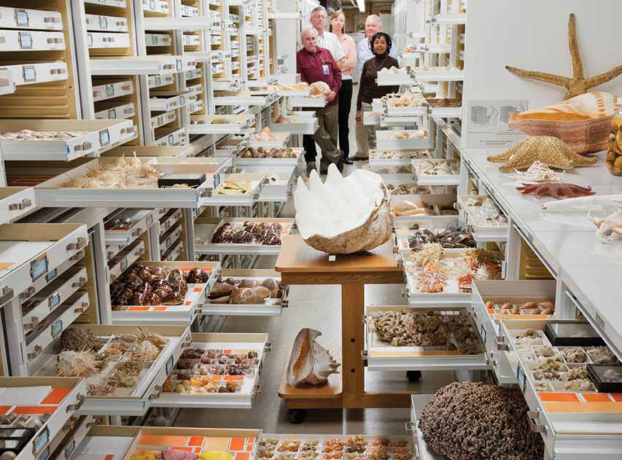
Museum Collections
~1,600 natural history collections
in the US
1-2 billion specimens
in the US
3-4 billion specimens worldwide
Smithsonian

Slide 6

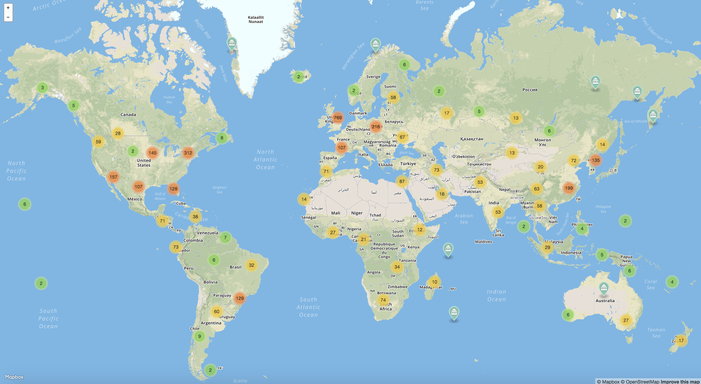
Herbaria
3,400 herbaria
400,000,000 specimens!
Thiers 2020

Slide 7


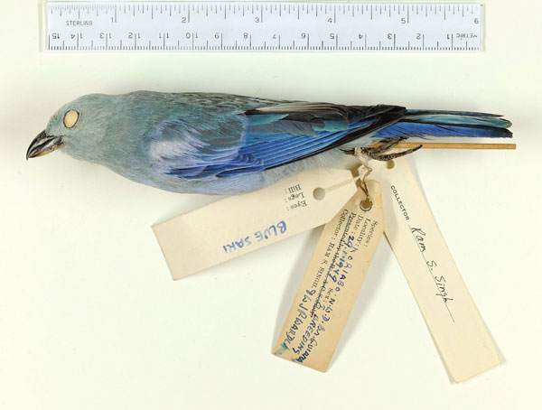
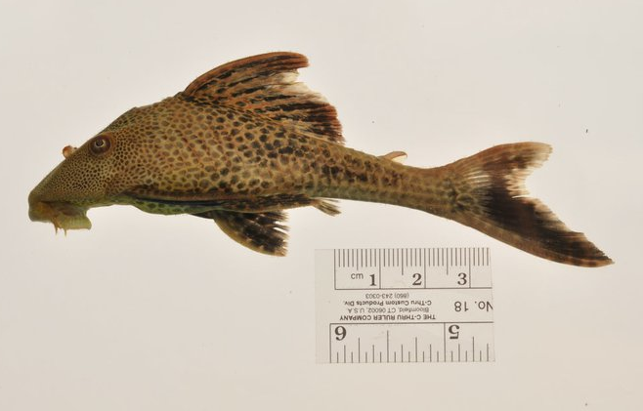
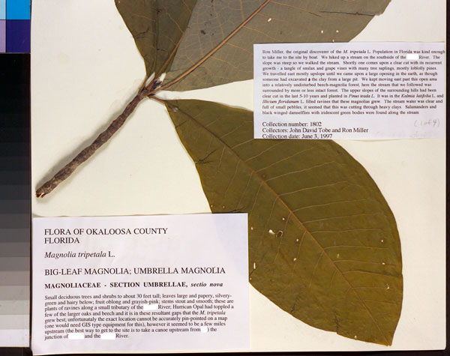
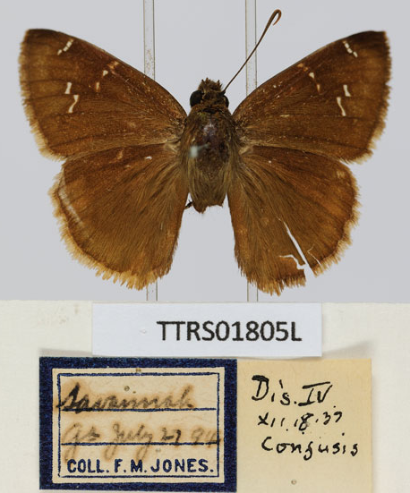
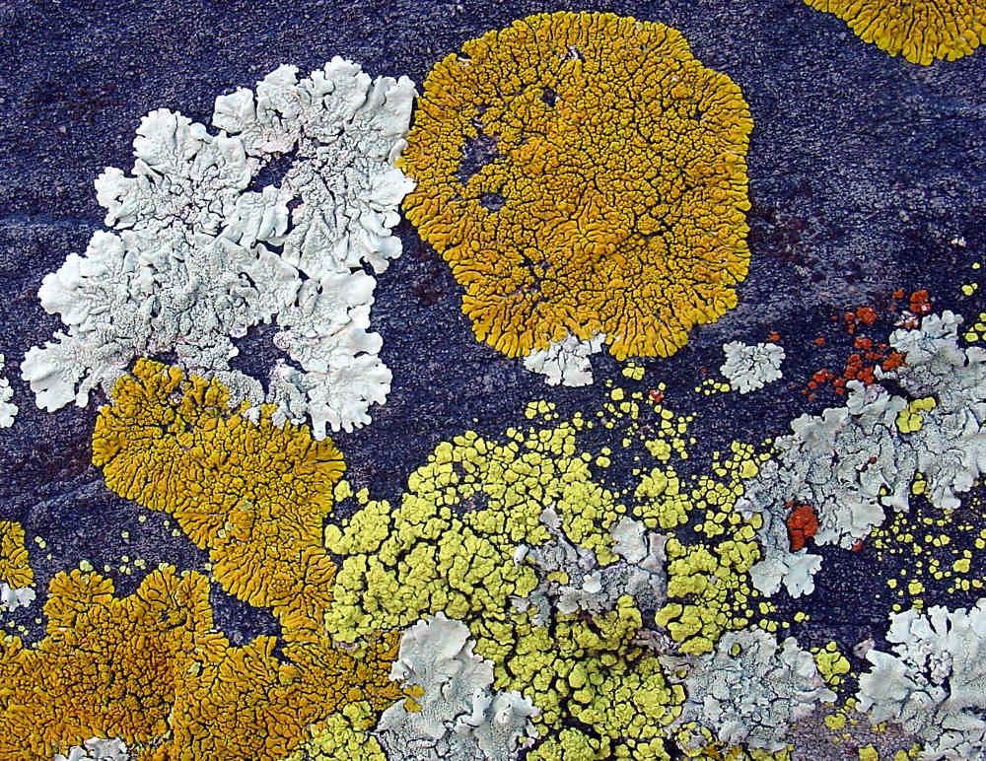
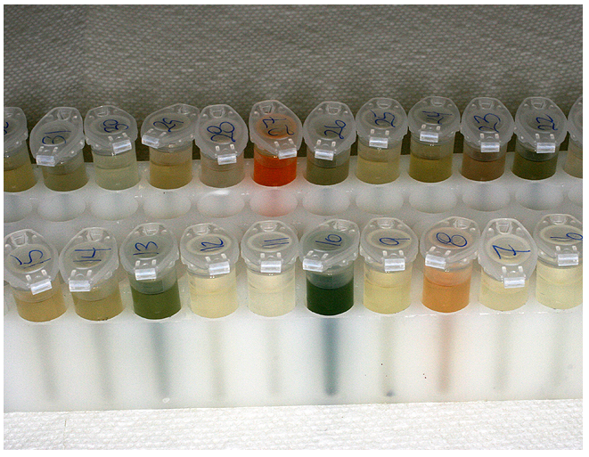
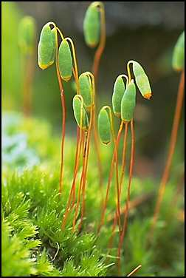
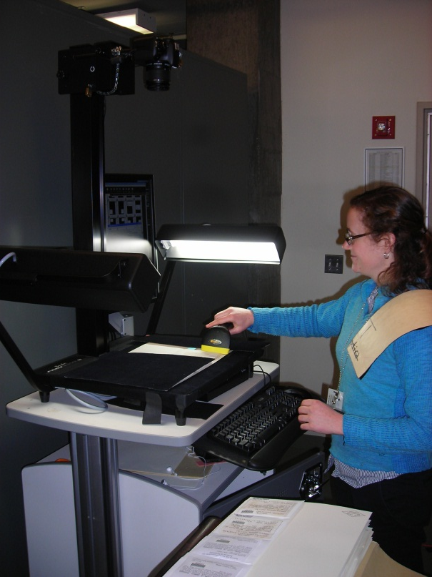
iDigBio: www.idigbio.org
National Coordinating Center
For Digitization of Biodiversity Collections
Ingest, serve, integrate data:
Localities
Dates
Images
Notes:
Harnessing these data—the goal of idigbio. Collab between arch rivals UF FSU

Slide 8
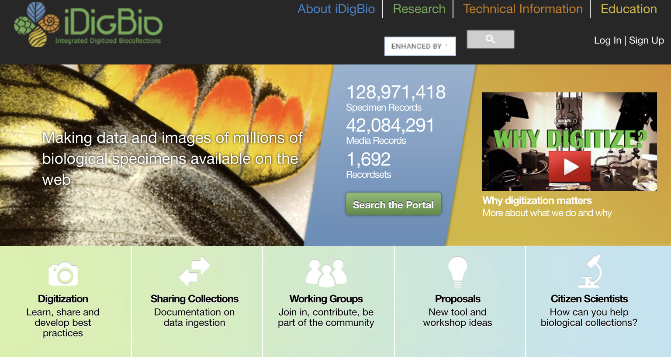
Digitized Data & Biodiversity Research
www.idigbio.org

Slide 9
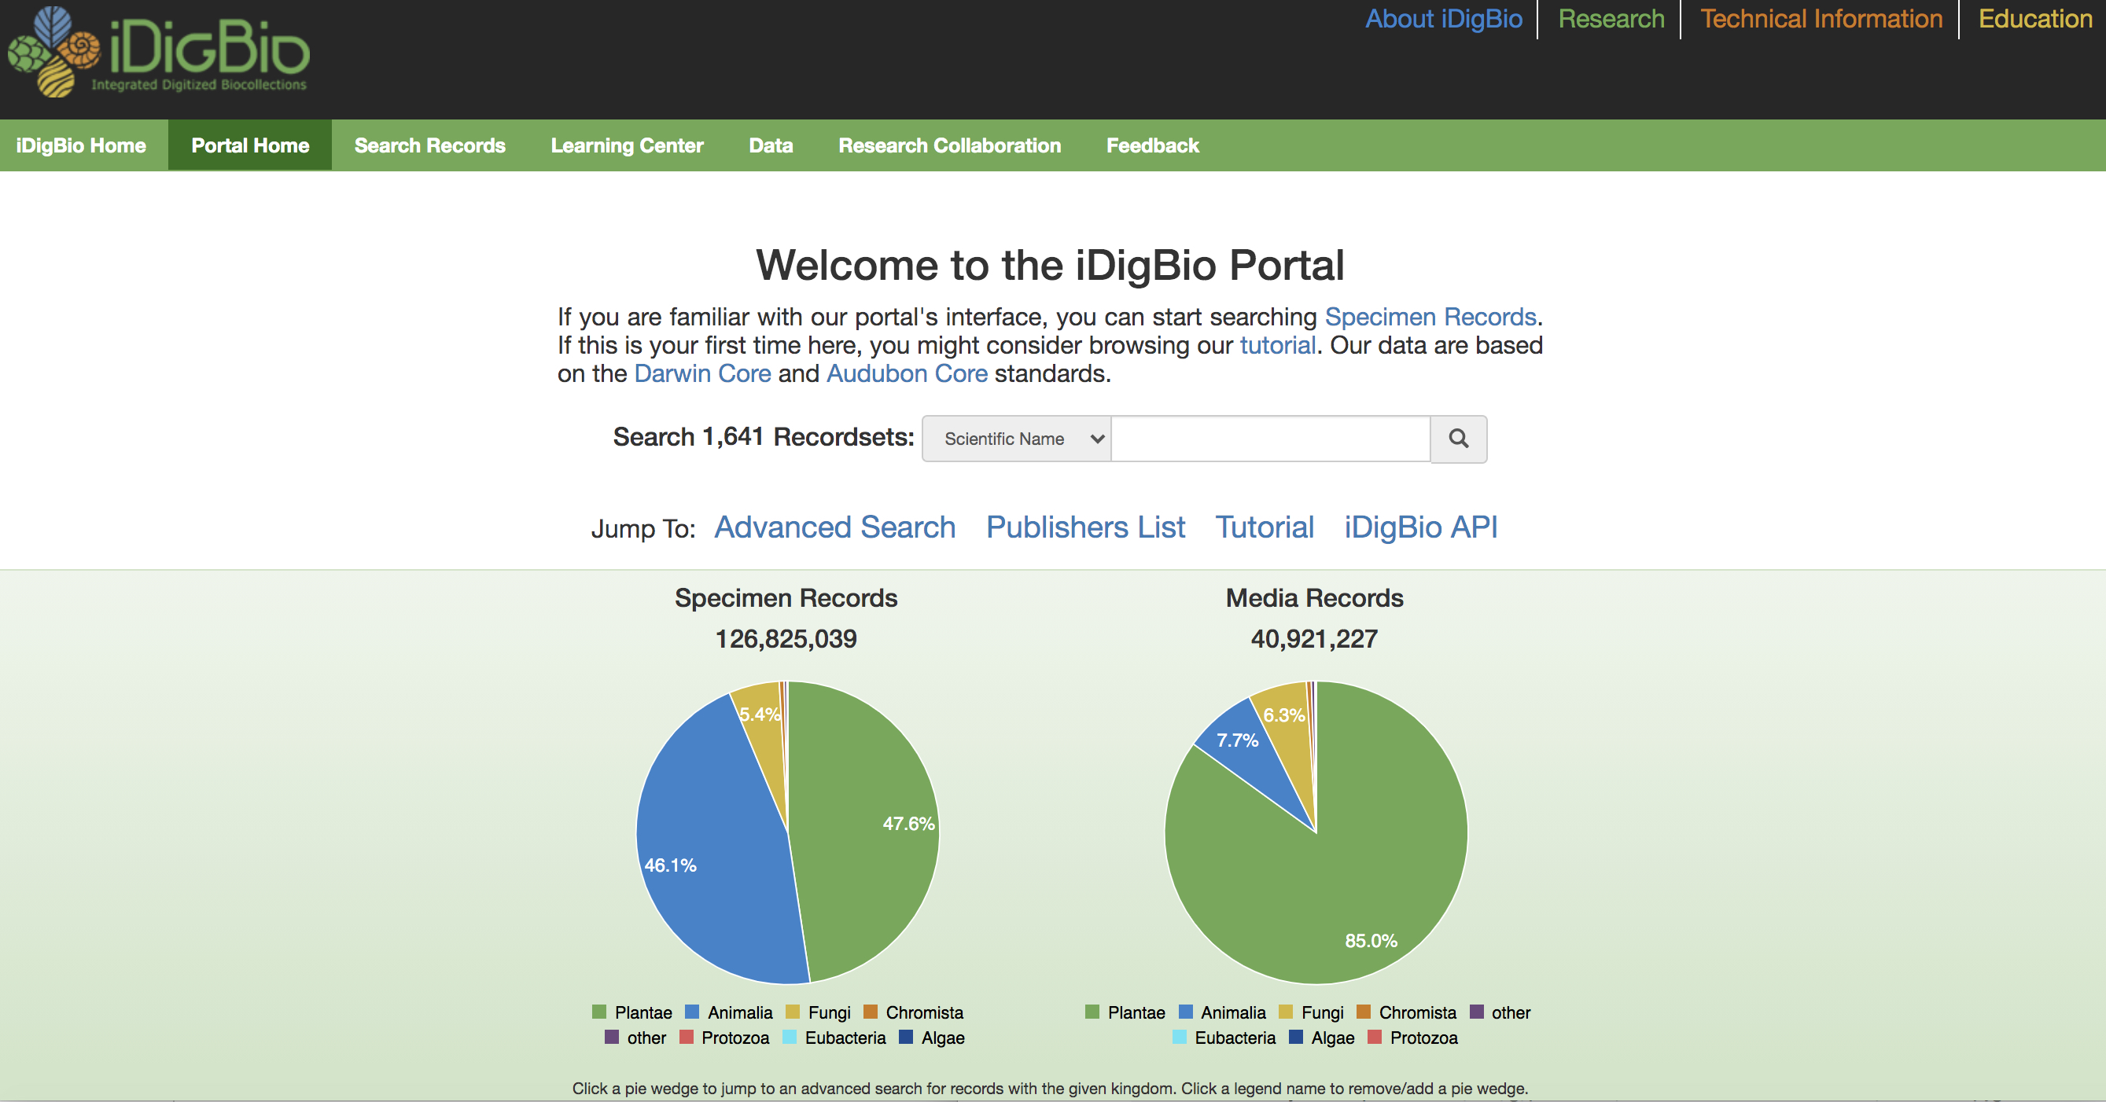
Digitized Data & Biodiversity Research
Digitized Data & Biodiversity Research
www.idigbio.org

Slide 10
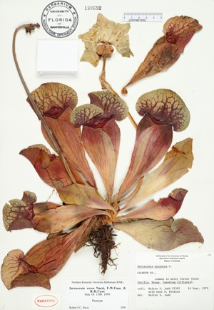
Label Data from Herbarium Specimens
Scientific name –
including authority
Date
Collector
Location – state, county,
specific site,
GPS coordinates
Associated species
Notes

Slide 11
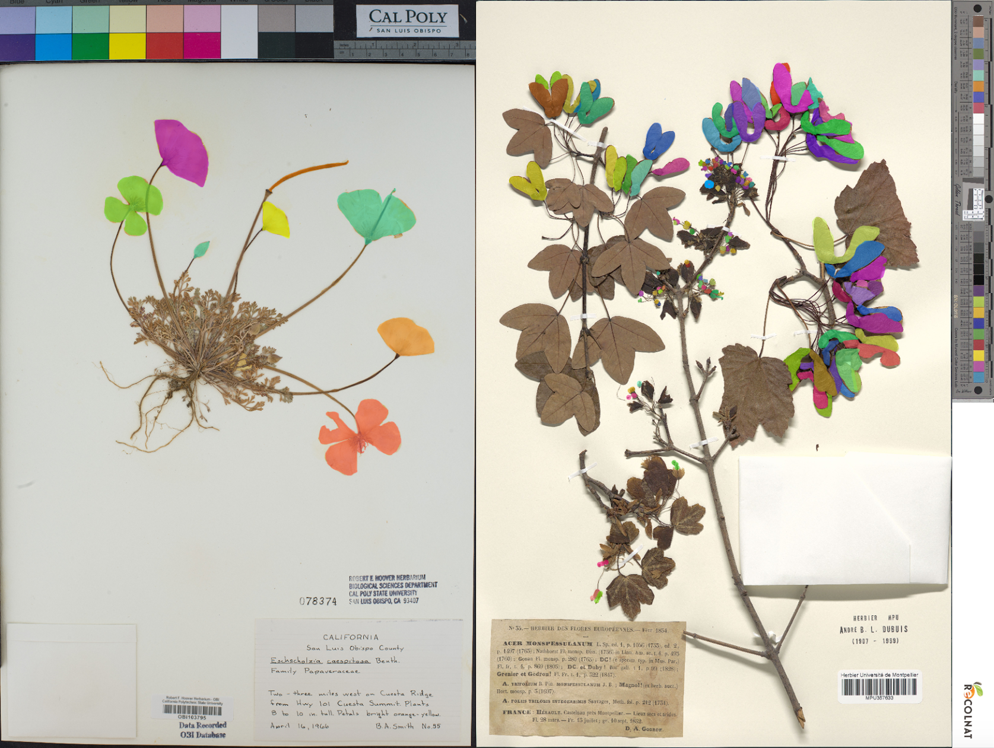
Machine Learning & Biodiversity Research
Pearson et al. 2020
Carranza-Rojas et al. 2017

Slide 12
Machine Learning & Biodiversity Research
June 2020: Herbarium Specimen Images
Phenology (2)
Morphology
Herbivory
Species Identification (2)
Software: Leaf Detection
Software: Leaf Recognition and Measurement
Edited by P. Soltis, G. Nelson, A. Zare, E. Meineke

Slide 13
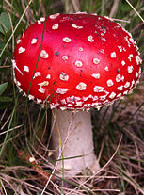
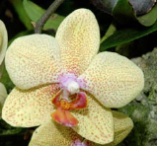

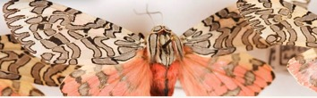
‘Big Data’ Research in Biodiversity Science
Monitoring shifts in biodiversity
Tracking invasive species
Ecological Niche Modeling, climate change
Past movements and climate change
Tracking phenological shifts
Landscape genetics
Integration of ENM with phylogeny
Community phylogenetics/assembly
Biogeography

Slide 14
Overview of Day’s Activities
9:00 9:10 9:20 9:35 10:15 10:20 10:50 11:05 11:55 12:15 12:45 1:00 1:10 1:40 2:00 2:30 2:45 2:55 3:10 3:30 3:40 3:50 4:00 4:40 5:00 | Welcome and Overview of the Workshop – Pam iDigBio Portal – Pam Data Downloads – Lauren Data Cleaning – Shelly Outlier Detection - Tal Georeferencing – Andre Break Climate Processing – Shelly Climatic Niche – Shelly Lunch Question Session Applications of ENMs – Doug Ecological Niche Models – Shelly Interpreting ENM Results – Shelly Post-ENM analysis – Shelly Break/Question Session Intro to BiotaPhy – Doug Overview of Phylogenetic Diversity (PD) – Hannah Hands-on PD Demo – Maria Overview of Alpine Biodiversity Project – Hector Overview of OCBIL (Old, Climatically Buffered, Infertile Landscapes) Project – Maria Correlating Chromosome and Climate Evolution – Jon Computing with Heterogeneous Species Occurrence Data for Global Analyses – CJ Question Session End
Notes:
Here is our outline of activities

Slide 15
Specimen Localities in iDigBio

Slide 16
Search the iDigBio Portal
www.idigbio.org

Slide 17
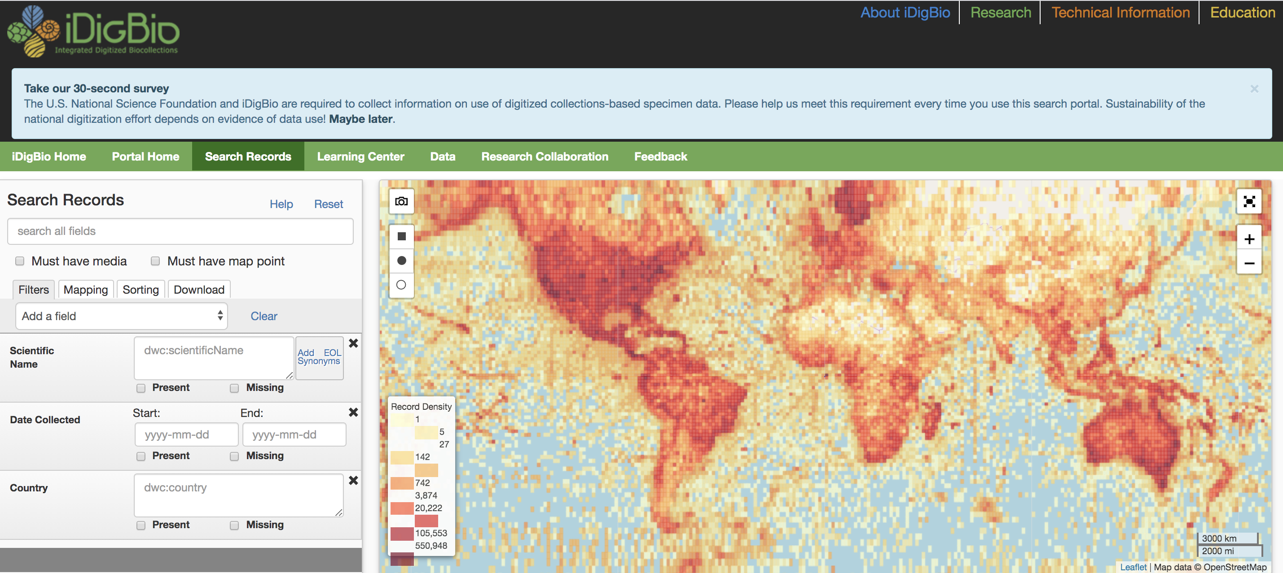
Search the iDigBio Portal

Slide 18
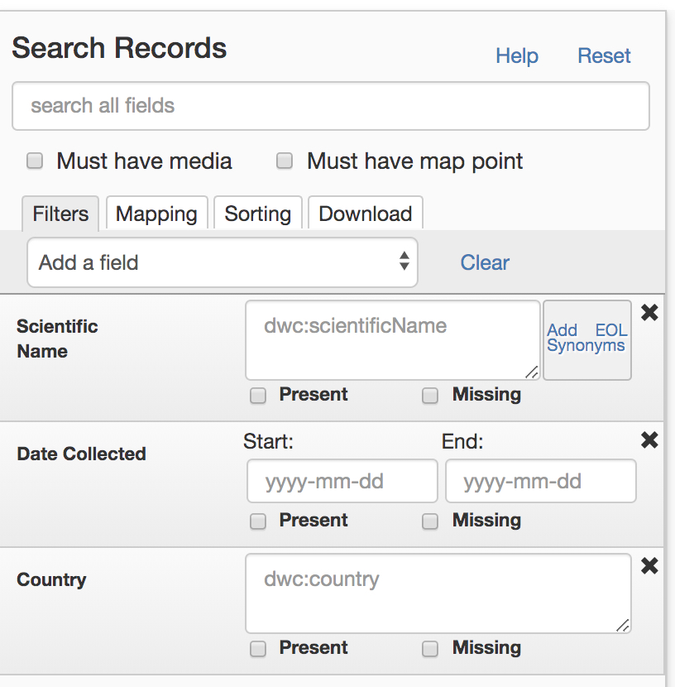
Search the iDigBio Portal – Specify Search Criteria

Slide 19
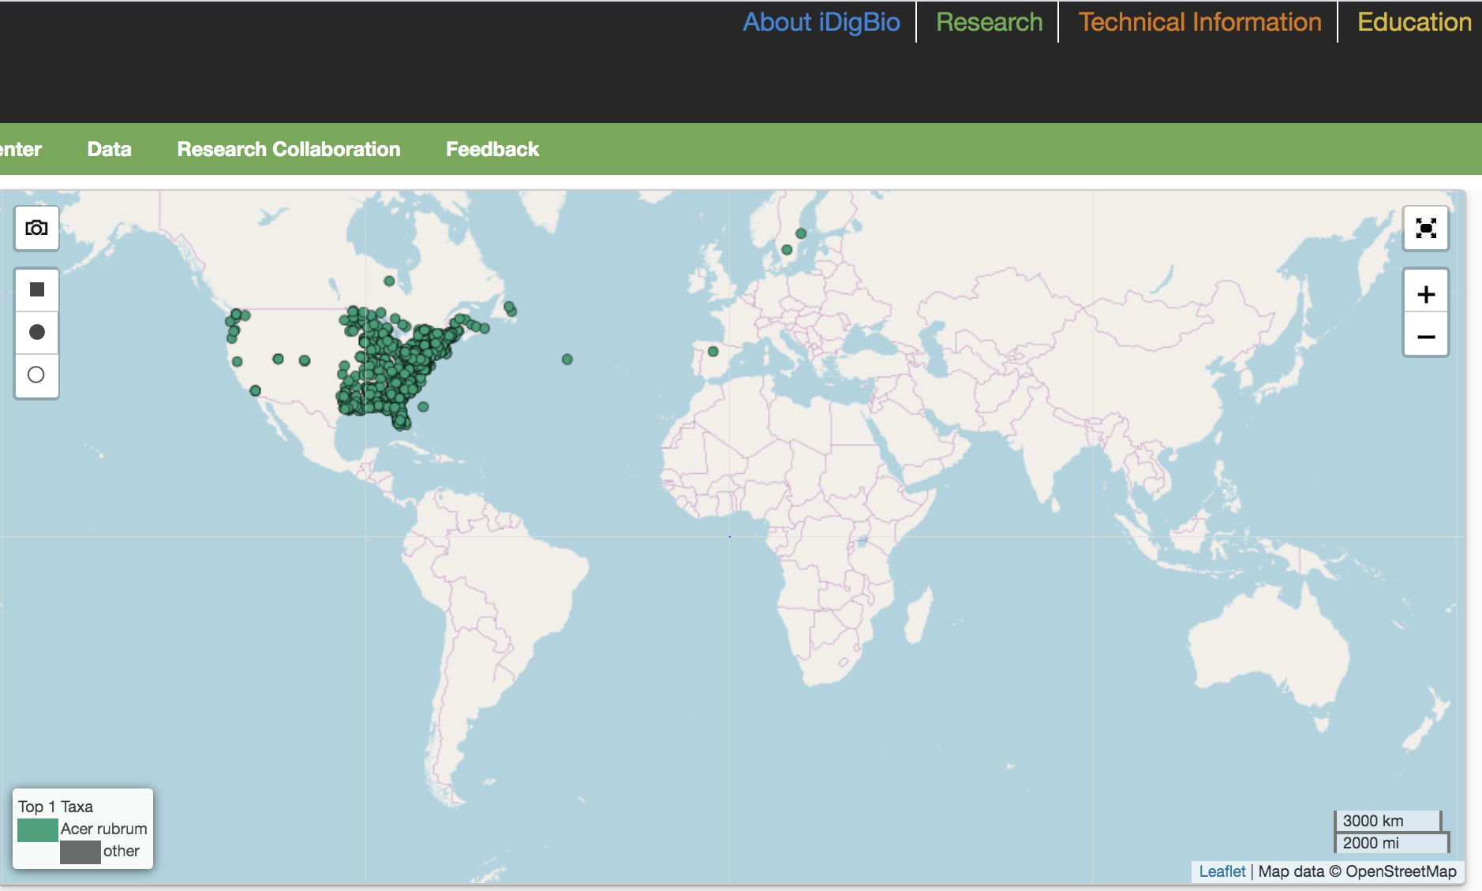
Search the iDigBio Portal – Results

Slide 20
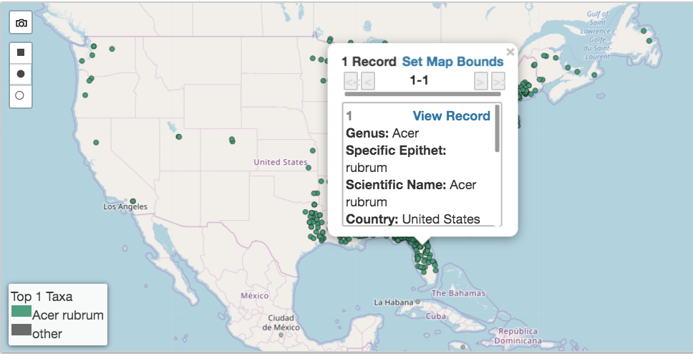
Search the iDigBio Portal – Record Summary

Slide 21
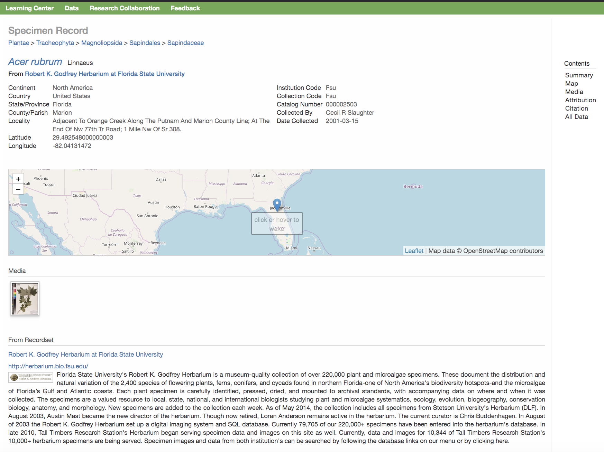
Search the iDigBio Portal – Specimen Record

Slide 22
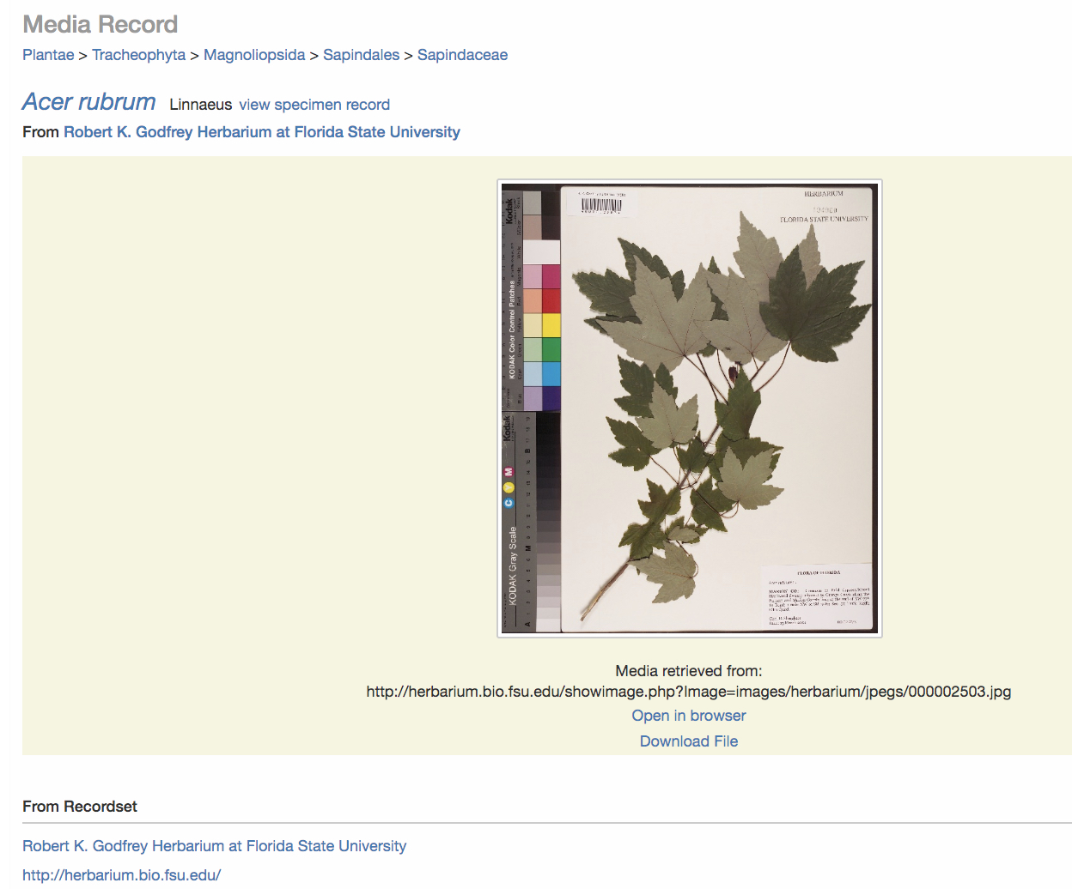
Search the iDigBio Portal – Link to Media Record (Image)

Slide 23
Search the iDigBio Portal

Slide 24
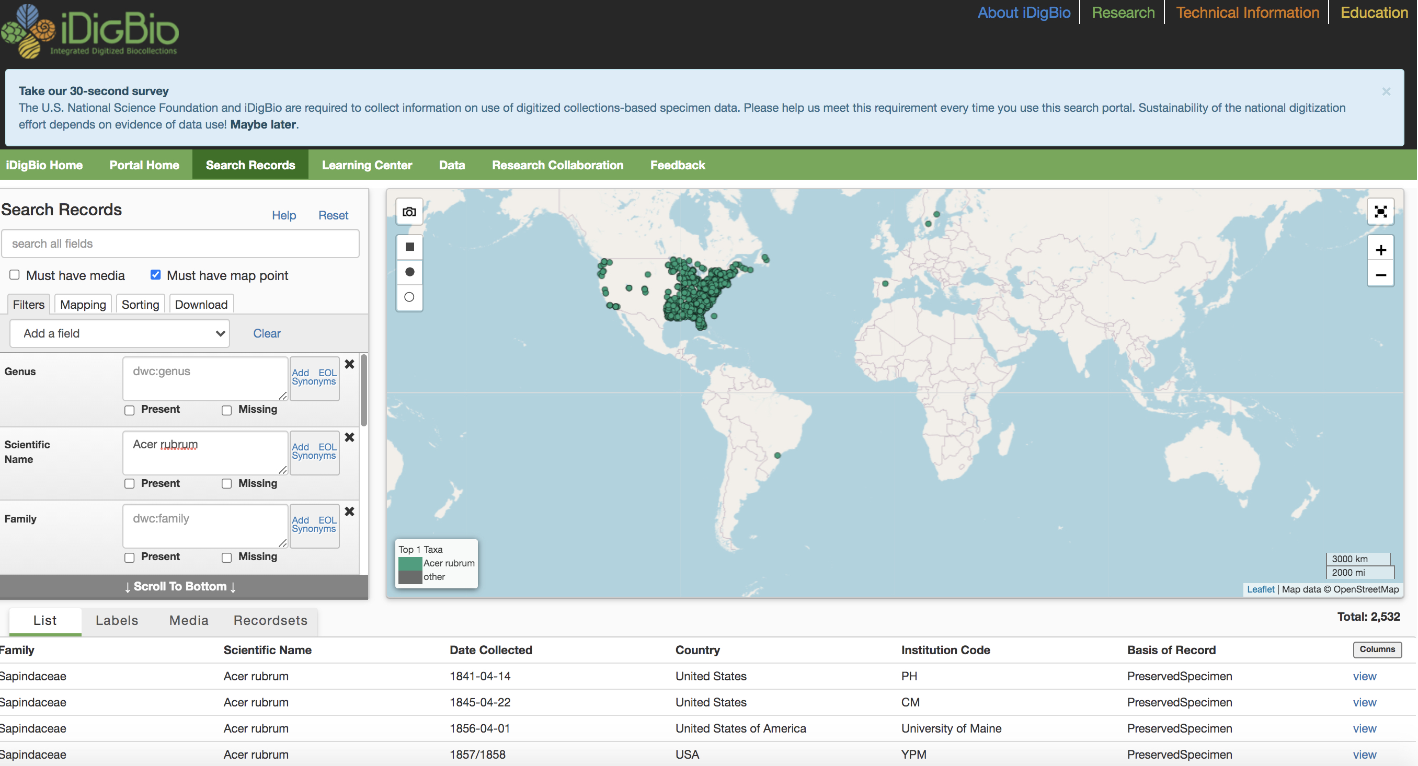
Search the iDigBio Portal

Slide 25
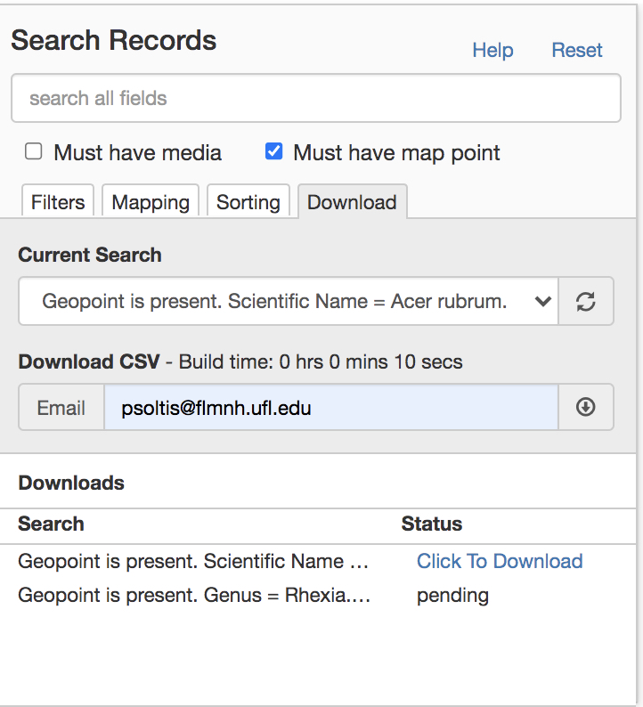
Search the iDigBio Portal

Slide 26
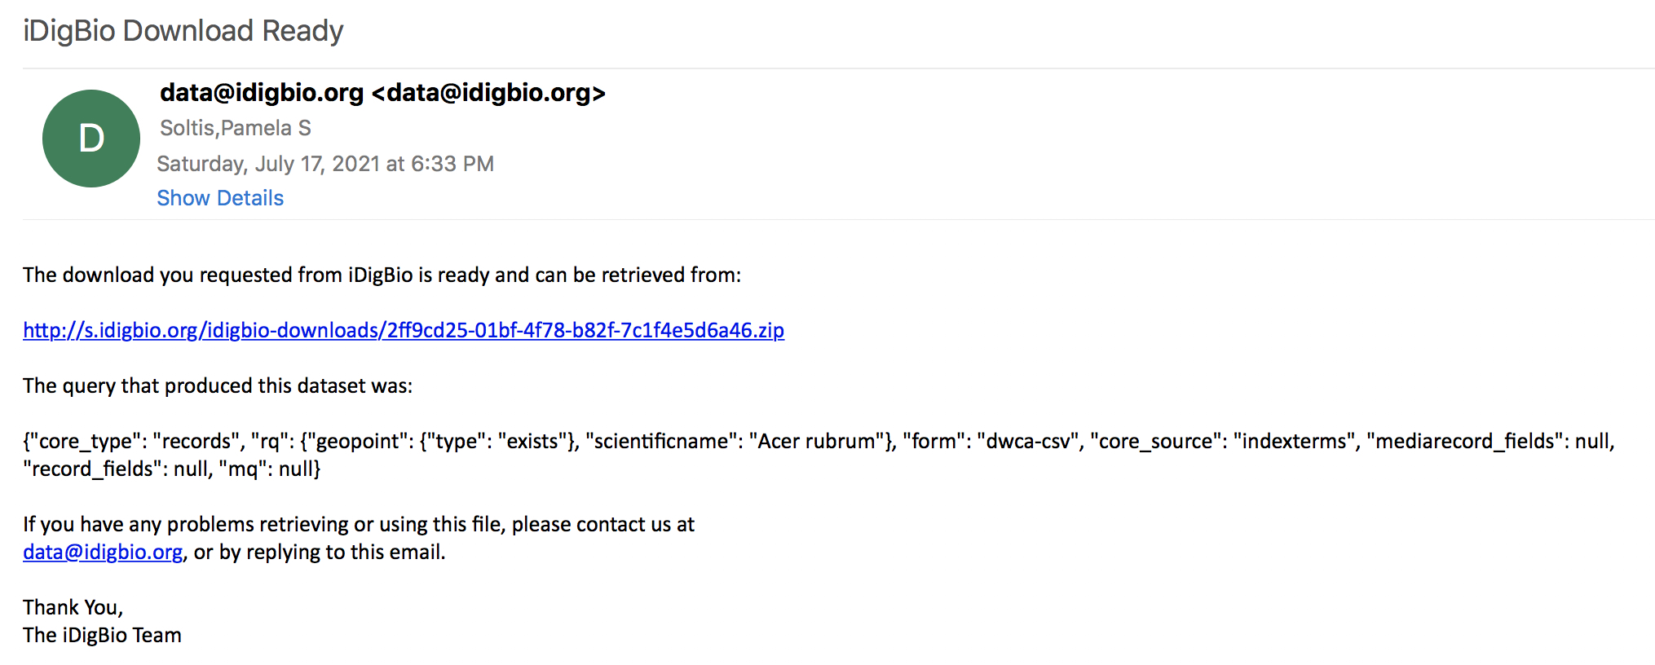
Search the iDigBio Portal

Slide 27
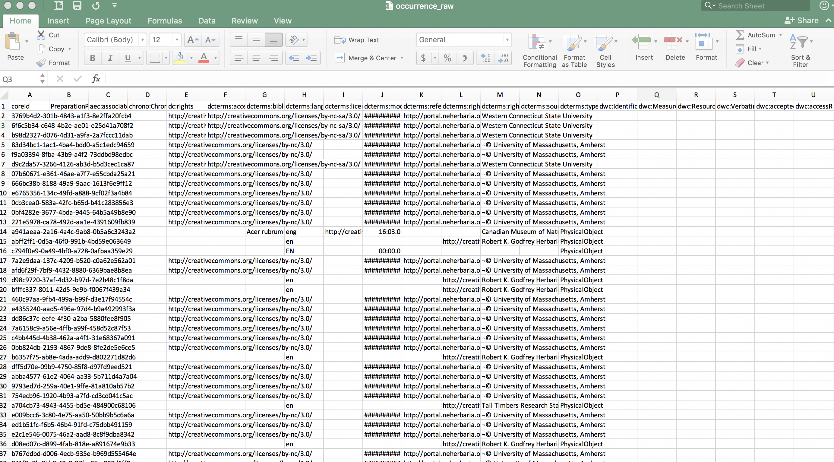
Search the iDigBio Portal

